Slide 1
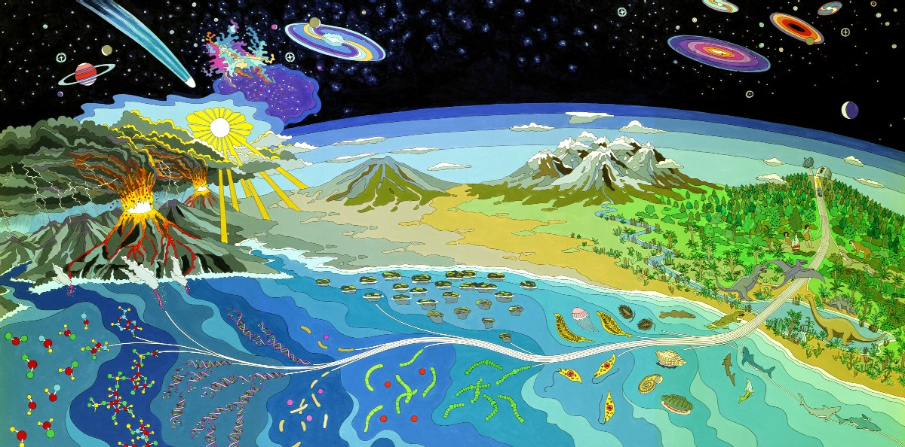
Mural at NASA Ames Research Center
Darwin’s Coral of Life, tree shape and indications for early extinctions due to increased environmental temperature.

Slide 2
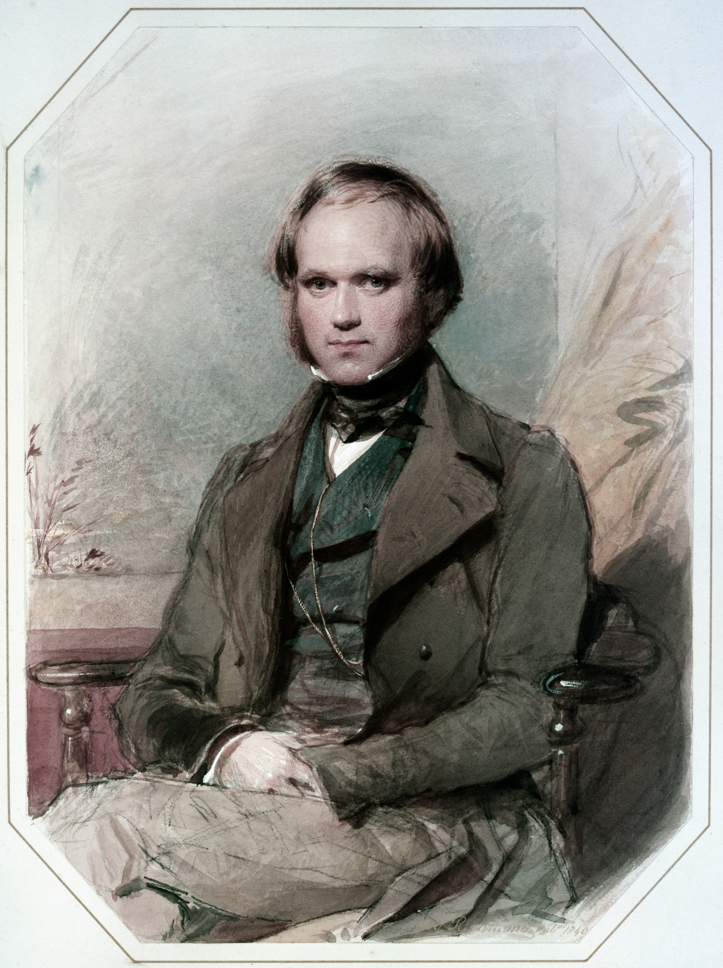
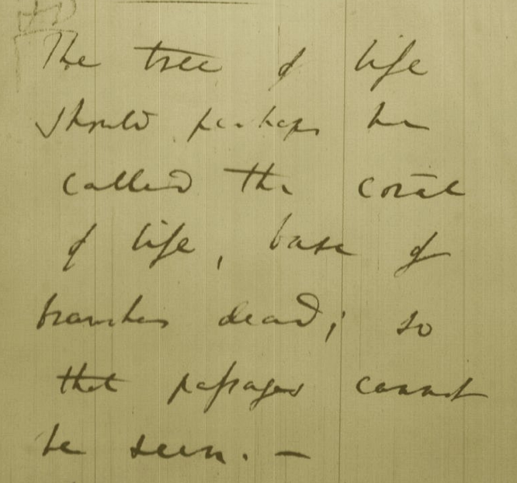
Tree, Web, or Coral of Life?
“The tree of life should perhaps be called the coral of life, base of branches dead”
Charles Darwin
painted by George Richmond in the late 1830
Page B26 from Charles Darwin’s (1809-1882) notebook (1837/38)

Slide 3
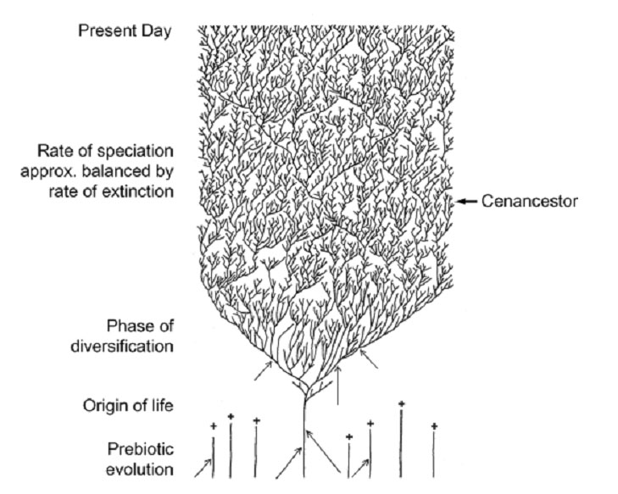
The Coral of Life (Darwin)
ZHAXYBAYEVA and GOGARTEN (2004):
Cladogenesis, Coalescence and the Evolution of the Three Domains of Life.
Trends in Genetics 20 (4): 182- 187
Notes:
The “Coral of Life” and the transfer of characters from now extinct into surviving lineages

Slide 4
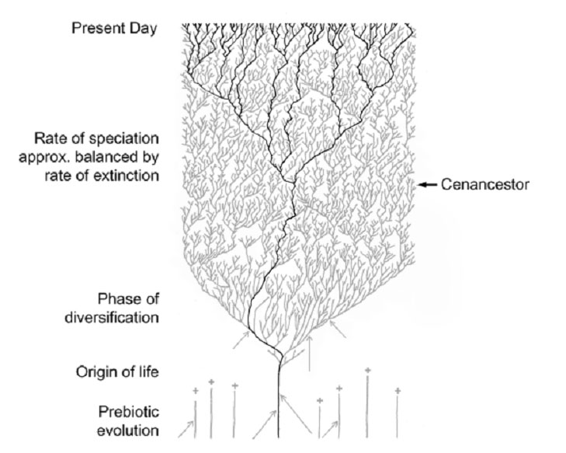
The Coral of Life (Darwin)
ZHAXYBAYEVA and GOGARTEN (2004):
Cladogenesis, Coalescence and the Evolution of the Three Domains of Life.
Trends in Genetics 20 (4): 182- 187
Notes:
The “Coral of Life” and the transfer of characters from now extinct into surviving lineages

Slide 5
The Coral of Life (Darwin)
ZHAXYBAYEVA and GOGARTEN (2004):
Cladogenesis, Coalescence and the Evolution of the Three Domains of Life.
Trends in Genetics 20 (4): 182- 187
Notes:
The “Coral of Life” and the transfer of characters from now extinct into surviving lineages

Slide 6
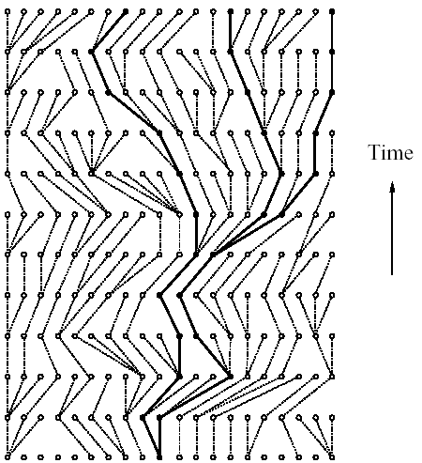
Coalescence – the process of tracing lineages backwards in time to their common ancestors. Every two extant lineages coalesce to their most recent common ancestor. Eventually, all lineages coalesce to the cenancestor.
t/2
(Kingman,
1982)
Illustration is from J. Felsenstein, “Inferring Phylogenies”, Sinauer, 2003

Slide 7
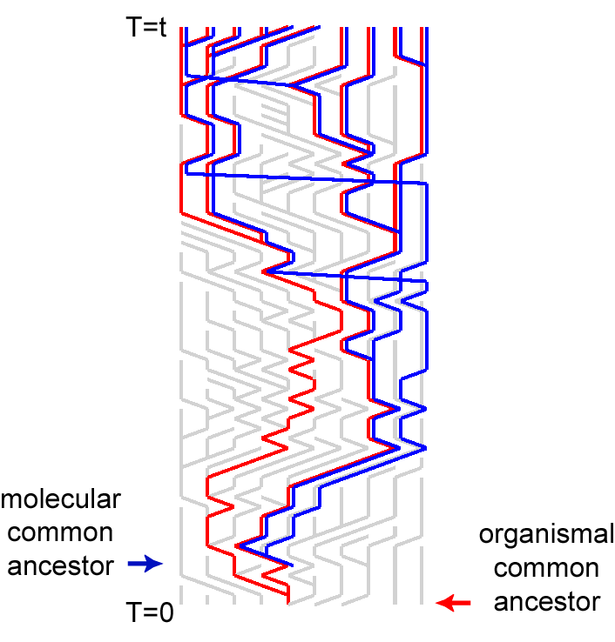
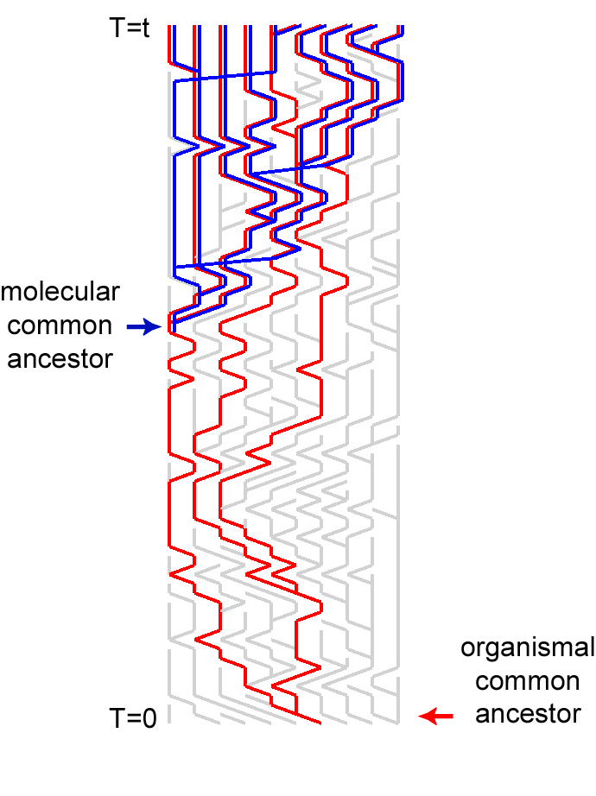
Simulations of organismal evolution by coalescence
One extinction and one speciation event per generation
Horizontal transfer event once in 10 generations
RED: organismal lineages (no HGT)
BLUE: molecular lineages (with HGT)
GRAY: extinct lineages
RESULTS:
Most recent common ancestors are different for organismal and molecular phylogenies
Different coalescence times
Long coalescence of the last two lineages

Slide 8
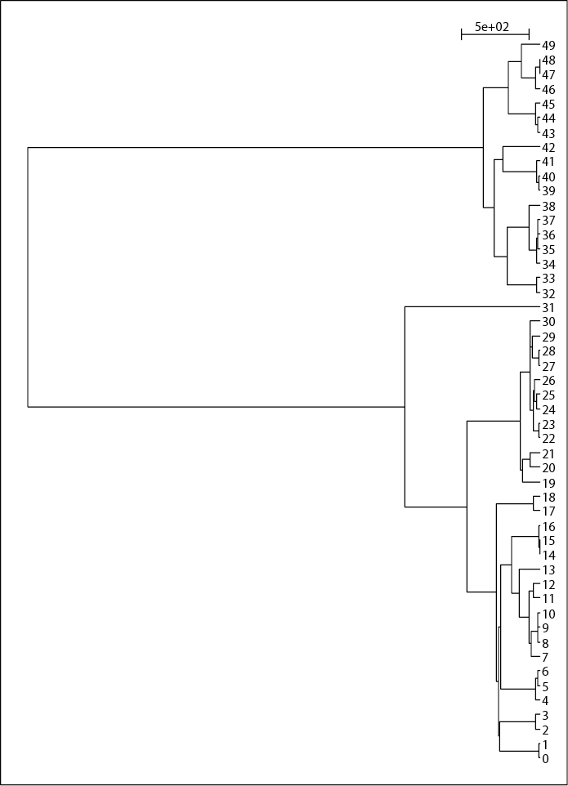
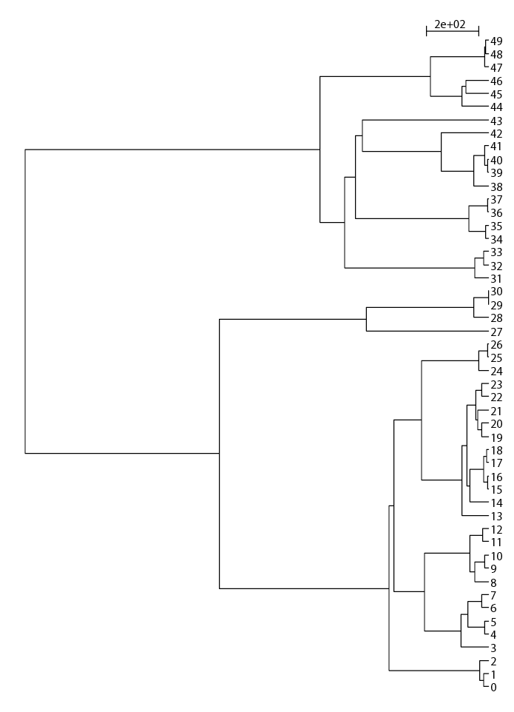
EXTANT LINEAGES FOR THE SIMULATIONS OF 50 LINEAGES

Slide 9
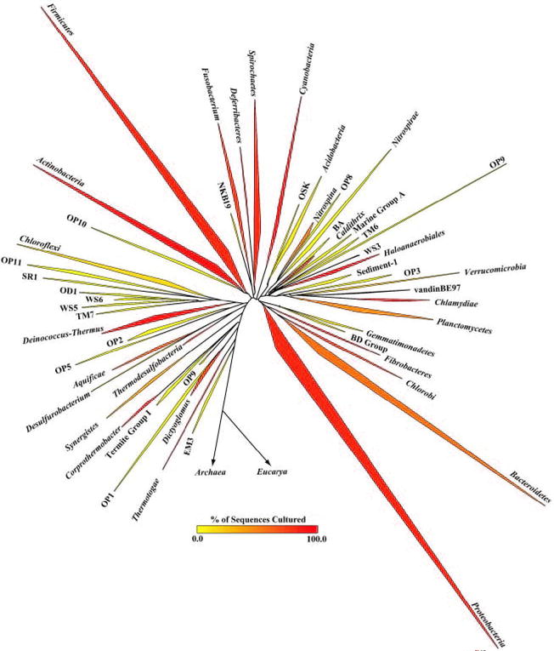
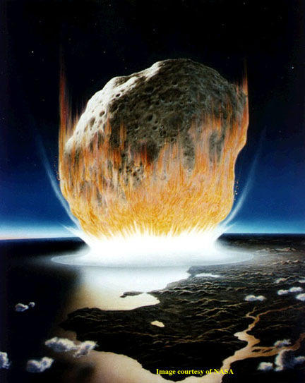
The deviation from the “long branches at the base” pattern could be due to
under sampling
an actual radiation
  due to an invention that was not transferred
  following a mass extinction
Bacterial 16SrRNA based phylogeny (from P. D. Schloss and J. Handelsman, Microbiology and Molecular Biology Reviews, December 2004.)

Slide 10
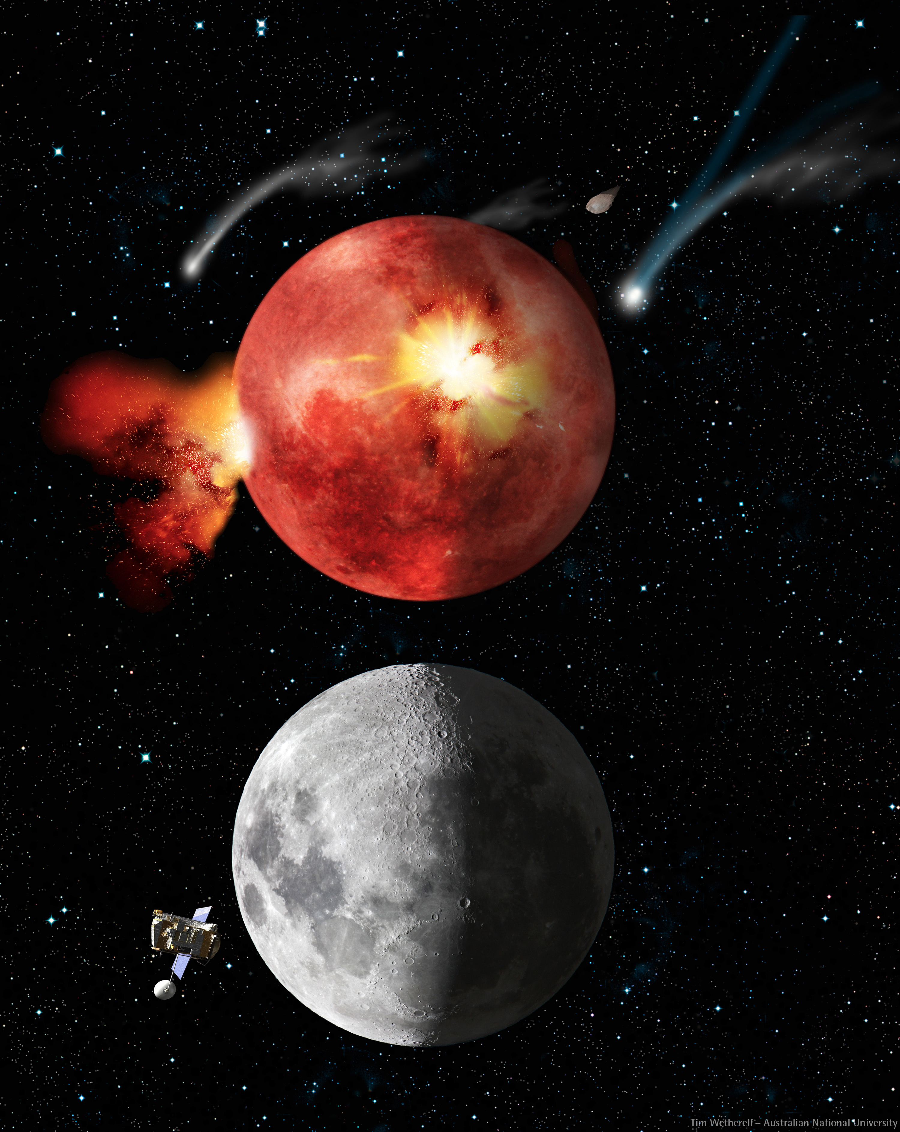
Lunar Cataclysm and Today
From: http://en.wikipedia.org/wiki/Late_Heavy_Bombardment

Slide 11
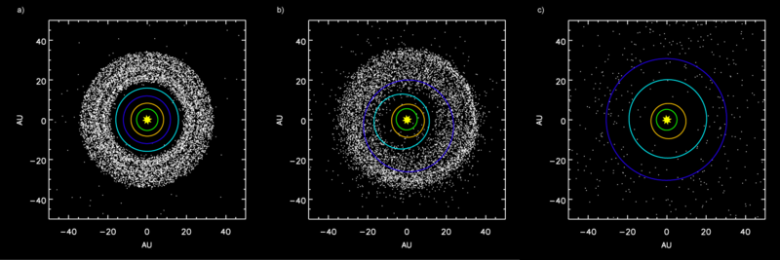
Simulation showing the outer planets and the Kuiper belt:
a) Before Jupiter–Saturn 2:1 resonance.
b) Scattering of Kuiper belt objects into the Solar System after the orbital shift of Neptune.
c) After ejection of Kuiper belt bodies by Jupiter.
From: http://en.wikipedia.org/wiki/Late_Heavy_Bombardment

Slide 12
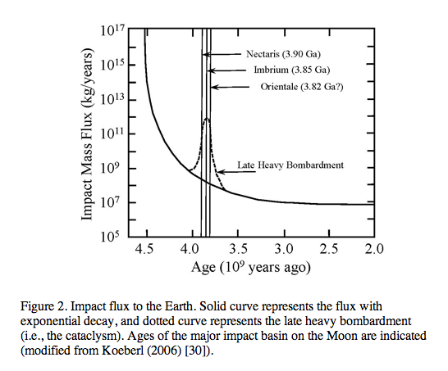
From: http://www.origin-life.gr.jp/3603/3603055/3603055.html
Alternative: tail of early heavy bombardment; however, see Marchi et al.
Nature 511:578-82 2014 for a recent update on the early impact history.

Slide 13
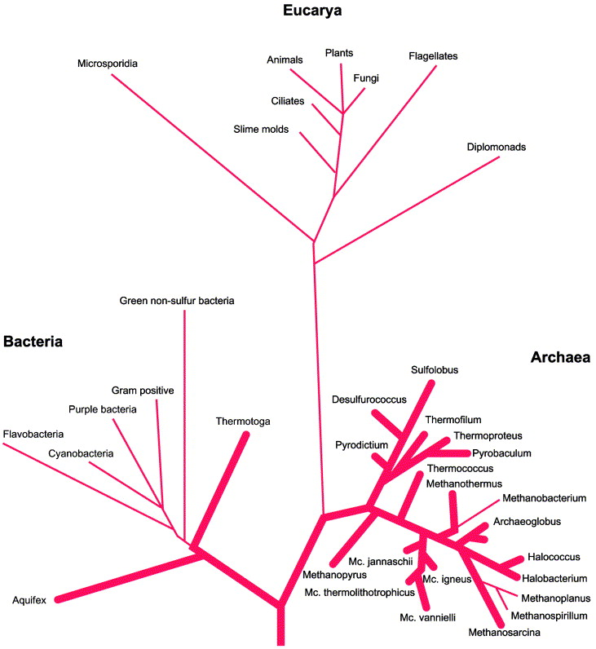
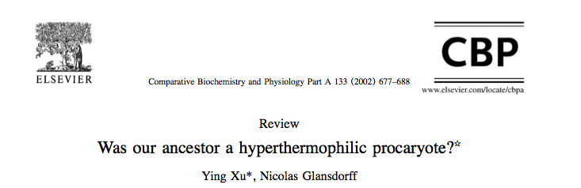
Fig. 3. The classical SSUrRNA distance tree, presented as rooted in the bacterial branch. Bold lines indicate extreme hyperthermophiles. From Stetter (1996).

Slide 14
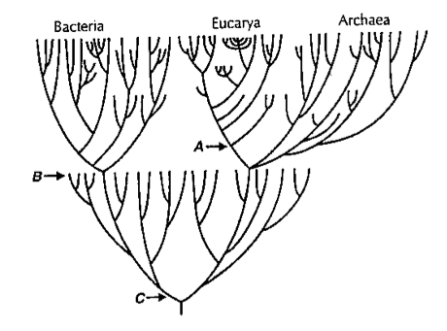
Near frustration of early life
From: Gogarten-Boekels M, Hilario E, Gogarten JP. Orig Life Evol Biosph. 1995 Jun;25(1-3):251-64. The effects of heavy meteorite bombardment on the early evolution
—the emergence of the three domains of life.

Slide 15
LUCA (located on the “bacterial branch”) was less thermophilic than the ancestor of the bacterial and archaeal domains
Boussau, B, Blanquart, S, Necsulea, A, Lartillot, N and Gouy, M (2008). Parallel adaptations to high temperatures in the Archaean eon. Nature 456(7224): 942-945
Reconstruction of ancestral protein and rRNA sequences
Based on IVYWREL and rRNA stem G+C content LUCA was less thermophilic than the domain ancestors.
Galtier, N, Tourasse, N and Gouy, M (1999).
A nonhyperthermophilic common ancestor to extant life forms. Science 283(5399): 220-221.8
rRNA 60°C80°C
IVYWREL (corrected for GC content) 20°C70°C

Slide 16
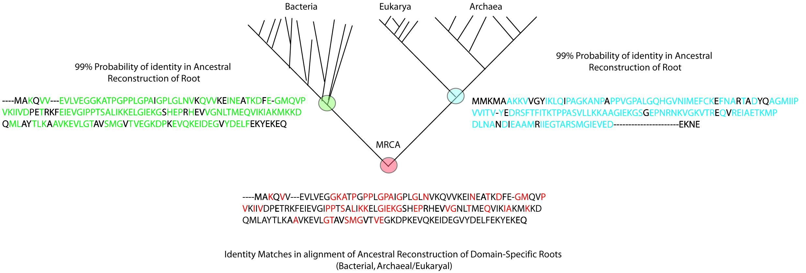
Compositional Stratigraphy
Fournier GP, Gogarten JP. 2007. Signature of a primitive genetic code in ancient protein lineages. J Mol Evol. 65(4):425-436
“We perform a compositional analysis of ribosomal proteins and ATPase subunits in bacterial and archaeal lineages, using conserved positions that came and remained under purifying selection before and up to the most recent common ancestor. An observable shift in amino acid usage at these conserved positions likely provides an untapped window into the history of protein sequence space, allowing events of genetic code expansion to be identified.”

Slide 17
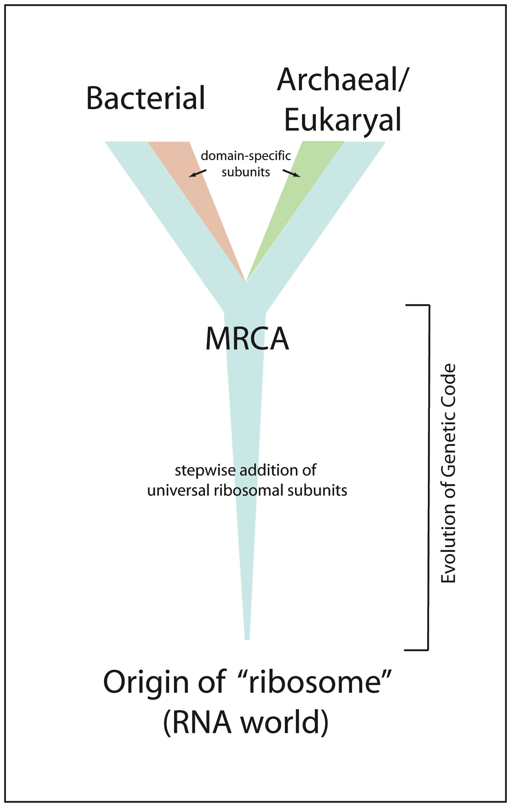
Evolution of the Ribosome
“Core” of ribosome consists of RNA + subset of ribosomal proteins universally conserved in all life (~29 proteins) (Harris et al., 2003)
Likely coevolved with genetic code within an RNA world (Wolf & Koonin, 2007)

Slide 18
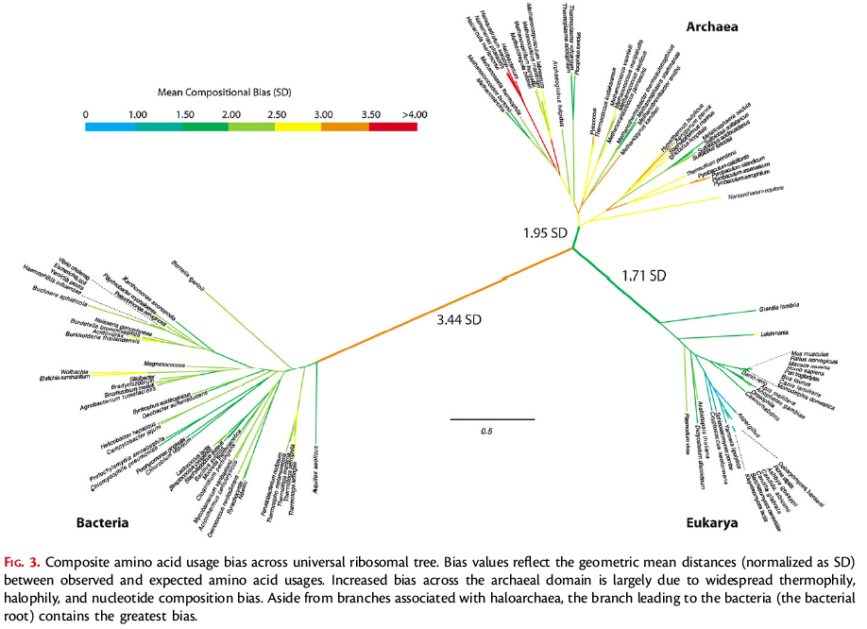
Rooting the Ribosomal Tree of Life using an Echo from the Early Expansion of the Genetic Code
(Fournier and Gogarten, MBE 2010)

Slide 19
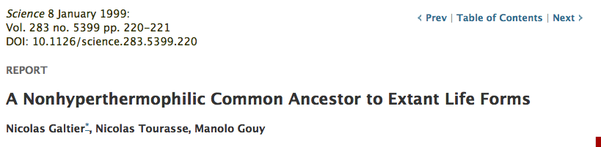

Slide 20
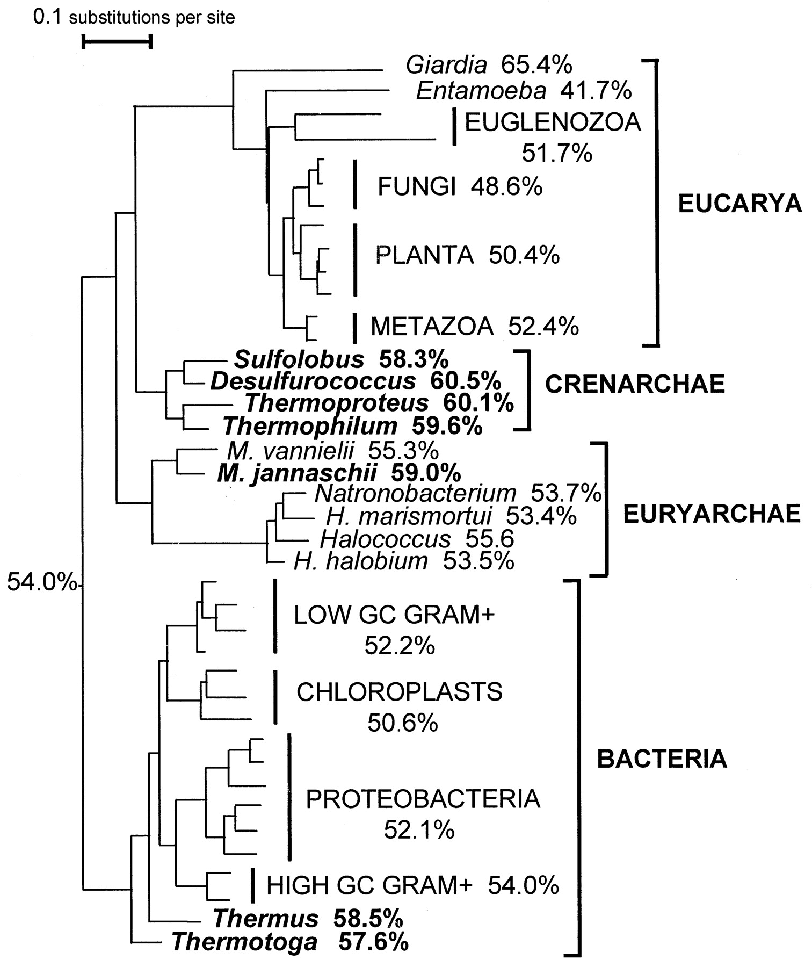
Maximum likelihood tree reconstructed from 40 LSU rRNA sequences (17). G+C contents of (groups of) sequences are given next to taxon names. The inferred ancestral G+C content appears next to the root. Two hundred topologies obtained by rearranging an initial neighbor-joining tree were evaluated. The monophyly of Bacteria, Eucarya, Crenarchaea, Euryarchaea, Euglenozoa, animals, green plants, fungi, high-GC Gram-positive bacteria, low-GC Gram-positive bacteria, proteobacteria, and chloroplasts was kept in all trees, but the remaining branching orders were randomly shuffled; 1409 complete, unambiguously aligned sites were used. The names of thermophilic species are in boldface.M, Methanococcus; H,Halobacterium.

Slide 21
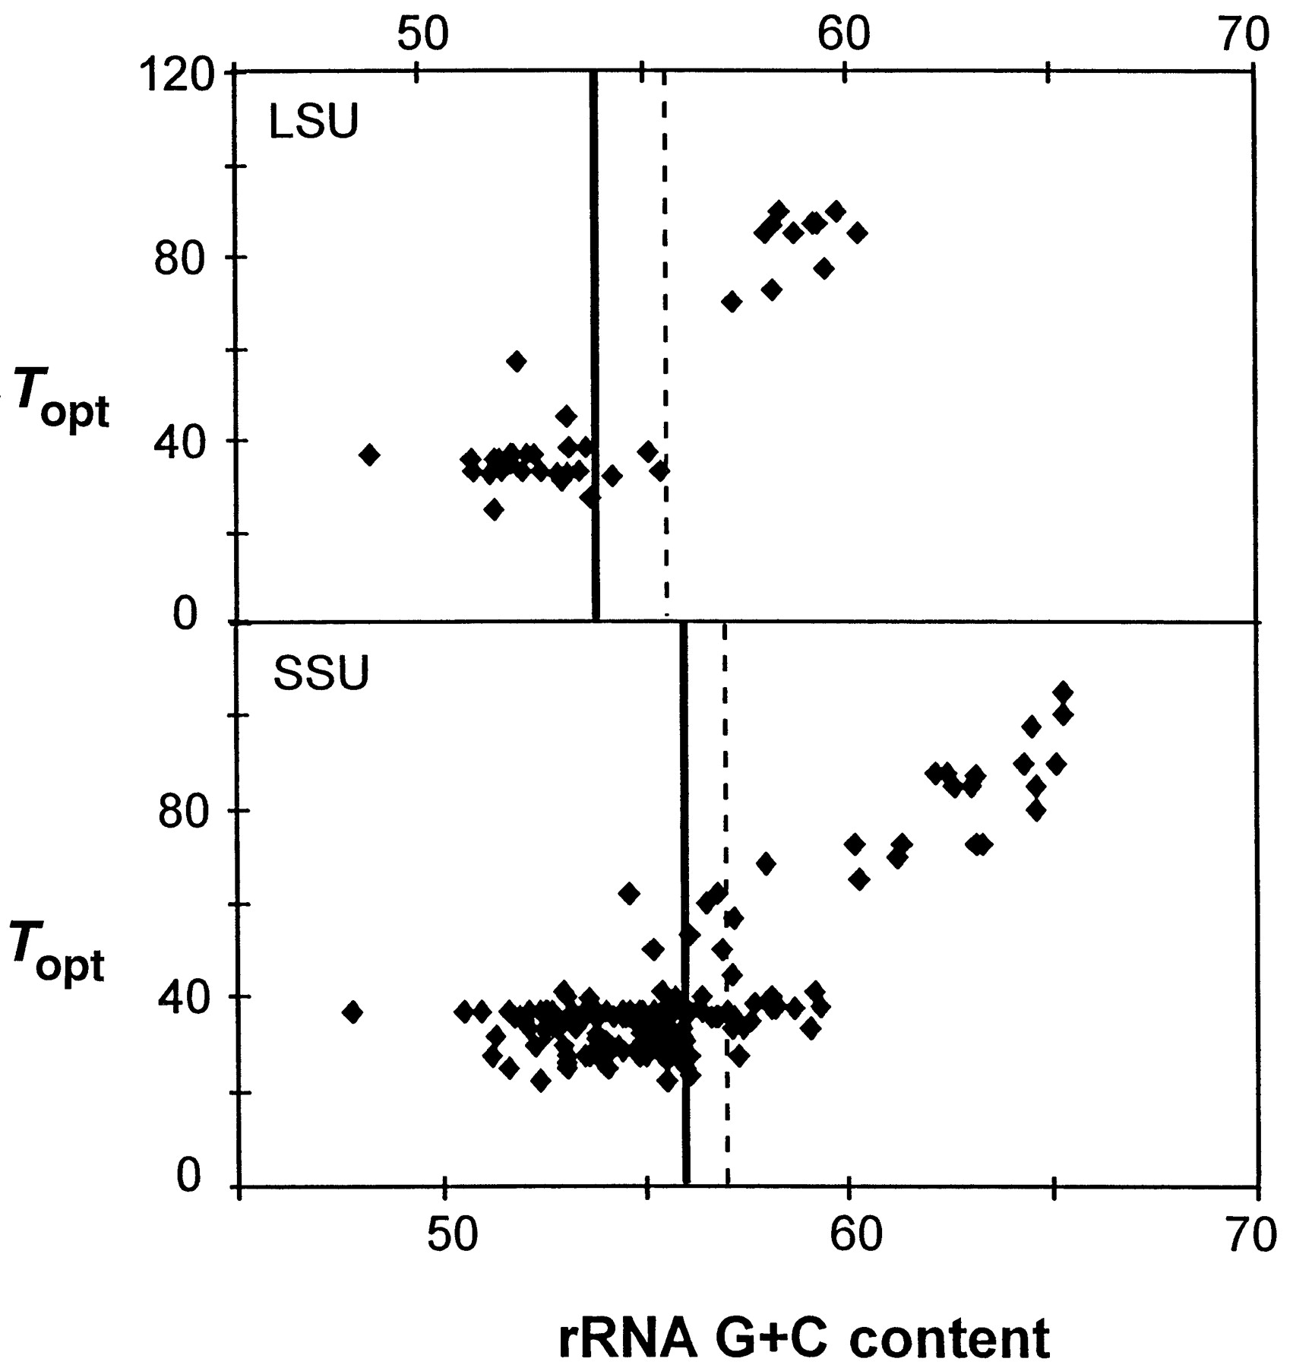
Figure 2 Correlation between optimal growth temperature and rRNA G+C content in prokaryotes.

Slide 22
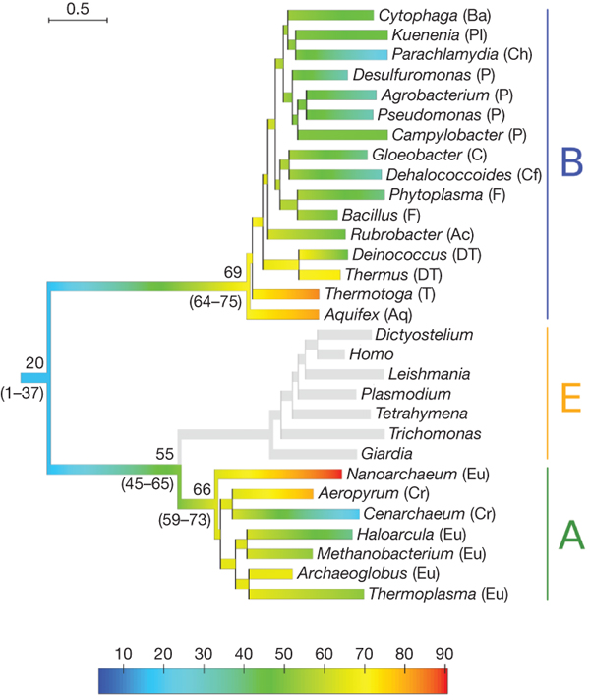

Evolution of thermophily over the tree of life.
B Boussau et al. Nature 000, 1-4 (2008) doi:10.1038/nature07393

Slide 23
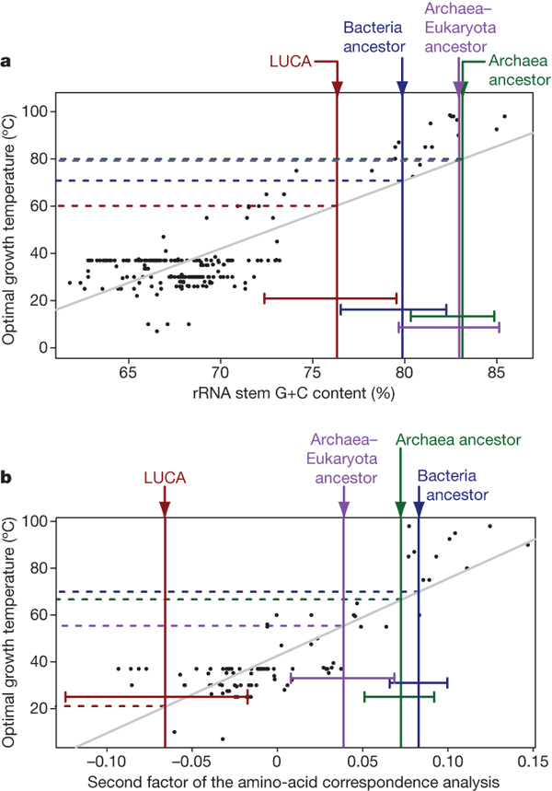
Correlations between sequence compositions and OGT,
and estimates of key ancestral compositions.
B Boussau et al. Nature 000, 1-4 (2008) doi:10.1038/nature07393

Slide 24
Conclusion
Tree shape and amino acid composition of ancestral sequences suggest a bottleneck due to increased environmental temperature at the base of the bacterial and archaeal domains.
Studies of horizontal gene transfers of aaRSs (e.g., rare form of SerRS) suggest that more than two lineages passed through this bottleneck.

Slide 25
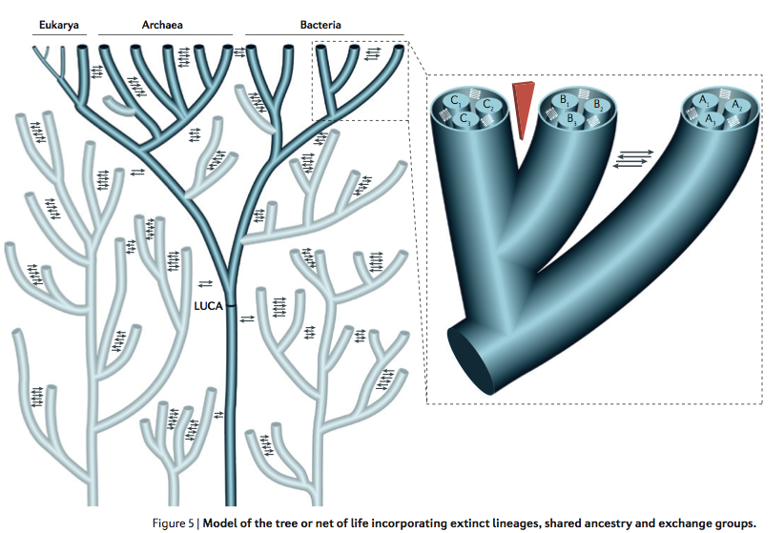
Many Thanks for your Attention!

